Slide 1
Drive Systems
Presented By:
Gary Pierson – Coach 1764
Chase Hill – COO 1764

Slide 2
Overview
Importance
Fundamental Considerations
Types of Drive Systems
Traction
Power and Power Transmission
Practical & Realistic Considerations
Credits

Slide 3
DRIVE SYSTEMS

Slide 4
Importance
The best drive train…
is more important than anything else on the robot
meets your strategy goals
can be built with your resources
rarely needs maintenance
can be fixed within 4 minutes
is more important than anything else on the robot

Slide 5
Fundamental Considerations
Know your resources
Cost, Machining Availability, Parts, Expertise, etc
Keep it simple (KISS)
Easy to design and build
Gets it up and running quicker
Easier to fix
Get it Running
Find out what is wrong
Practice for Driving
Time for Fine-Tuning
Give programing team TIME to work

Slide 6
Types of Drive Train
Drive Train Decision Depends on:
Team Strategy
Attributes needed
Resources available
Must sacrifice some attributes for others. No one system will perform all the above functions

Slide 7
Good Features to have to attain proper attributes
High Top Speed
High Power
High Efficiency/Low Losses
Correct Gear Ratio
Acceleration
High Power
Low Inertia
Low Mass
Correct Gear Ratio
Pushing/Pulling
High Power
High Traction
High Efficiency/Low Losses
Correct Gear Ratio
Obstacle Handling
Ground Clearance
Obstacle "Protection”
Drive Wheels on Floor
Accuracy
Good Control Calibration
Correct Gear Ratio
Climbing Ability
High Traction
Ground Clearance
Correct Gear Ratio
Reliability/ Durability
Simple
Robust
Good Fastening Systems
Ease of Control
Intuitive Control
High Reliability
Maneuverability
Good Turning Method
Ability to strafe

Slide 8
 | Importance | Mechanum Wide/Short | 4WD Trac/Omni Wide/Short
Acceleration | 5 | 3 | 4
Pushing/Pulling | 4 | 2 | 4
Ramp Handling | 4 | 3 | 4
Accuracy | 4 | 3 | 4
Reliability/Durability | 5 | 4 | 4
Ease of Control | 2 | 4 | 4
Maneuverability | 5 | 5 | 4
Cost | 4 | 2 | 4
Programming Complexity | 1 | 5 | 4
Weight | 3 | 2 | 3
Ball Collecting | 5 | 5 | 5
Total |  | 144 | 170

Slide 9
What types of Drives are Available?
2 Wheel Drive
4 Wheel Drive with 2 Gearboxes
4 Wheel Drive with 4 Gearboxes
6 Wheel Drive with 2 Gearboxes
Tank Drive and Treads
Omni-directional Drive Systems
Mecanum
Holonomic / Killough
Crab/Swerve
Other

Slide 10
2 Wheel Drive
Pros (+)
Easy to Design
Easy to Build
Light Weight
Inexpensive
Agile
Easy Turning
Fast
COTS Parts
Cons (-)
Not Much Power
Does not do well on ramps
Poor Pushing
Susceptible to spin outs.
Able to be pushed from the side
Driven Wheels
Gearbox
Gearbox
Motors can be driven in front or rear
Position of Driven Wheels:
Near Center of Gravity
for most traction
Front Drive for Max
Positioning
3) Lose Traction if weight not over wheels
Caster
or
Omni

Slide 11
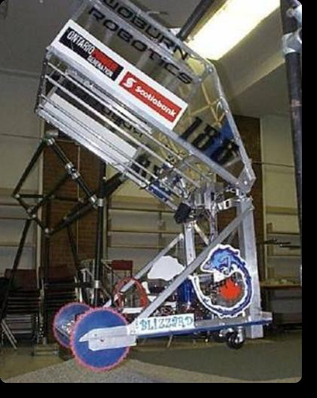
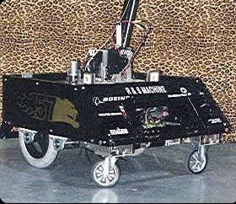
2 Wheel Drive: Examples

Slide 12
4 Wheel Drive – 2 Gearboxes
Driven Wheels
Pros (+)
Easy to Design
Easy to Build
More Powerful
Sturdy and stable
Wheel Options
Omni, Traction, Other
COTS Parts
Cons (-)
Not Agile
Turning can be difficult
Adjustment Needed
Slightly Slower
Requires belting or chain
Gearbox
Gearbox
Position gearboxes anywhere as needed for mounting and center of gravity
Position of Wheels:
Close together = better turning
Spread Apart = Straighter driving
Chain or belt
Driven Wheels

Slide 13
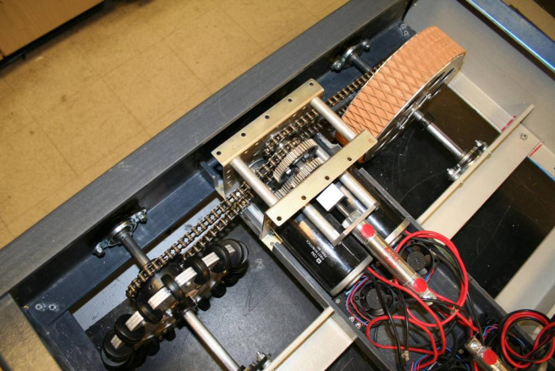
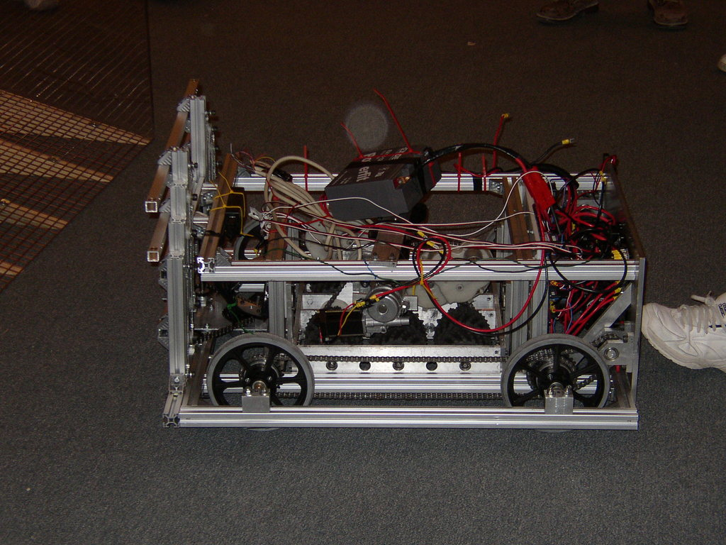
4 Wheel Drive – 2 Gearbox : Examples

Slide 14
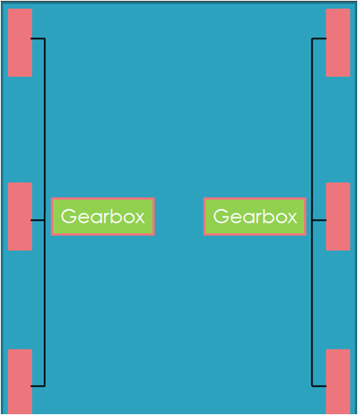
6 Wheel Drive – 2 Gearboxes
Pros (+)
Easy to Design & Build
Powerful
Stable
Agile
Turns at center of robot
Pushing
Harder to be high Centered
COTS Parts
Cons (-)
Heavy & Costly
Turning may or may not be difficult
Chain paths
Optional
Substitute Omni Wheel sets at either end
Traction: Depends on wheels
Pushing = Great w/ traction wheels
Pushing = Okay w/ Omni
2 Ways to be agile:
Lower Contact on Center Wheel
Omni wheels on back, front or both
Center wheel generally larger or lowered 1/8” - 1/4”
Rocking isn’t too bad at edges of robot footprint, but can be significant at the end of long arms and appendages

Slide 15
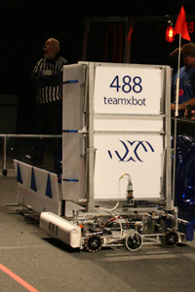
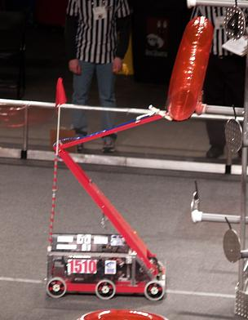
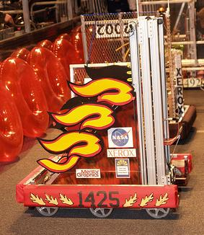
6 Wheel Drive - 2 Gearboxes Examples

Slide 16
4 Wheel Drive – 4 Gearboxes
Driven Wheels
Pros (+)
Easy to Design
Easy to Build
Powerful
Sturdy & Stable
Many Options
Mecanum, Traction, Omni, Combo
COTS Parts
Cons (-)
Heavy
Costly
Turning may or may not be difficult
Options
4 traction
+ Pushing, Traction, Straight
- Turning
All Mecanum; 2 traction & 2 Omni
+ Mobility
- Less traction, Less pushing
Gearbox
Gearbox
Types of wheels determine whether robot has traction, pushing ability, and mobility
If all traction wheels, keep wheel base short; difficult to turn.
Driven Wheels
Gearbox
Gearbox

Slide 17
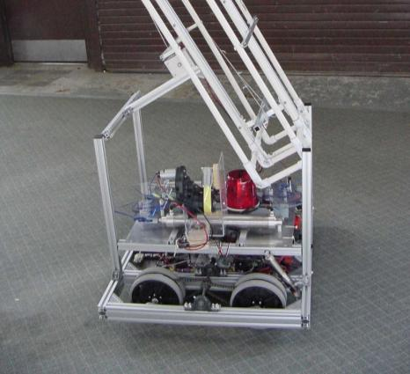
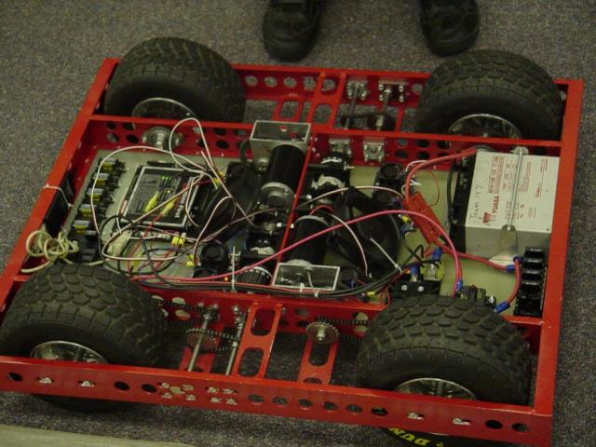
4 Wheel Drive – 4 Gearboxes: Examples

Slide 18
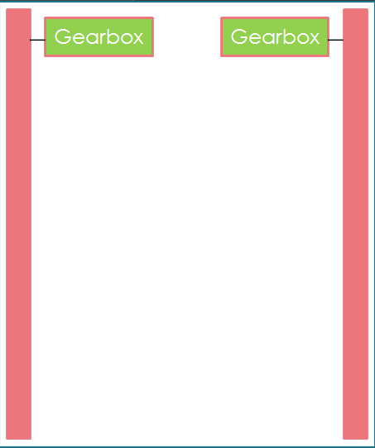
Tank Drive/Treads
Pros (+)
Climbing Ability
(best attribute)
Great Traction
Turns at Center
Pushing
Very Stable
Powerful
Cons (-)
Energy Efficiency
Mechanical Complexity
Difficult for student build teams
Turns can tear off treads
WEIGHT
Expensive
Repairing broken treads.
Lower track at center slightly to allow for better turning.

Slide 19
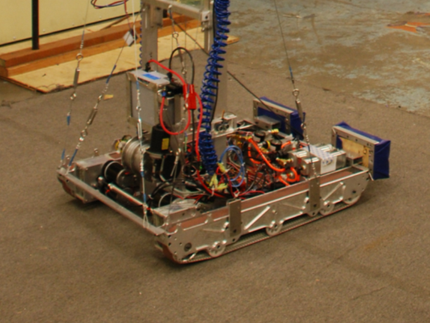
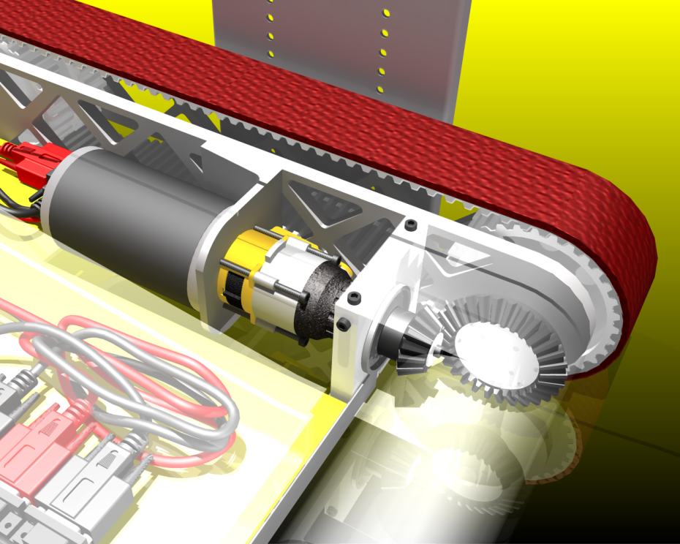
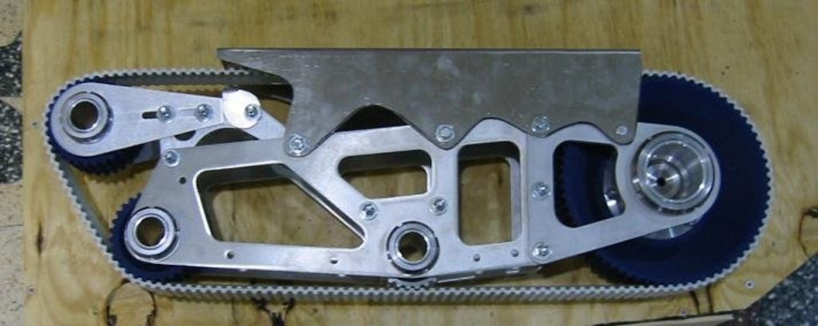
Tank Drive/Treads Examples

Slide 20
Omni-directional drives
“Omnidirectional motion is useless in a drag race… but GREAT in a mine field”
Remember, task and strategy determine usefulness

Slide 21
Omni: Mecanum
Pros (+)
Simple Mechanism
High Maneuverability
Immediate Turn
Simple Control
4 wheel independent
Simple mounting and chains
Turns around Center of robot
COTS Parts
Cons (-)
Braking Power
OK Pushing
Suspension for teeth chattering
Inclines
Software complexity
Drift (uneven weight distribution)
Expense
Motor(s)
Motor(s)
For best results, independent motor drive for each wheel is necessary.
Motor(s)
Motor(s)

Slide 22
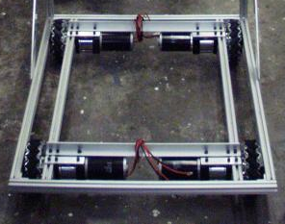
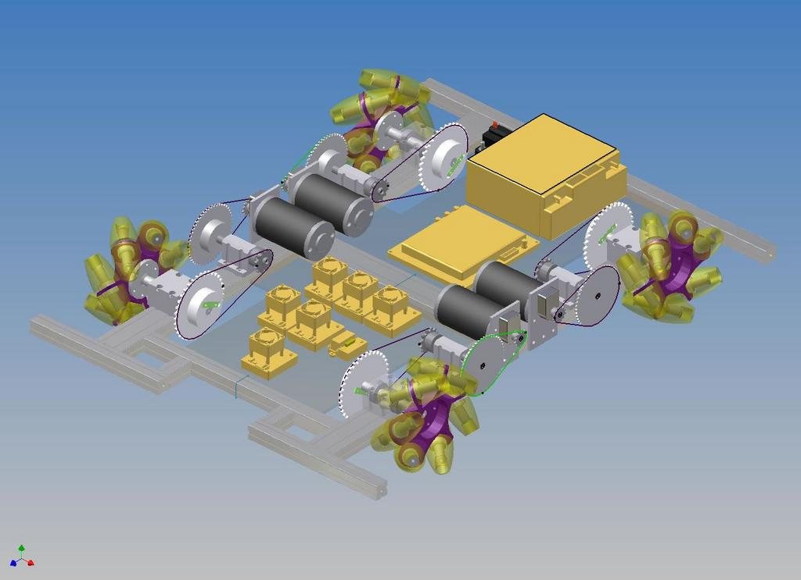
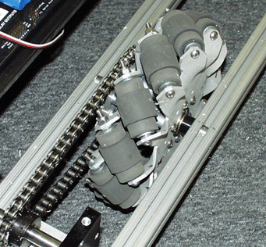
Omni: Mecanum Examples

Slide 23
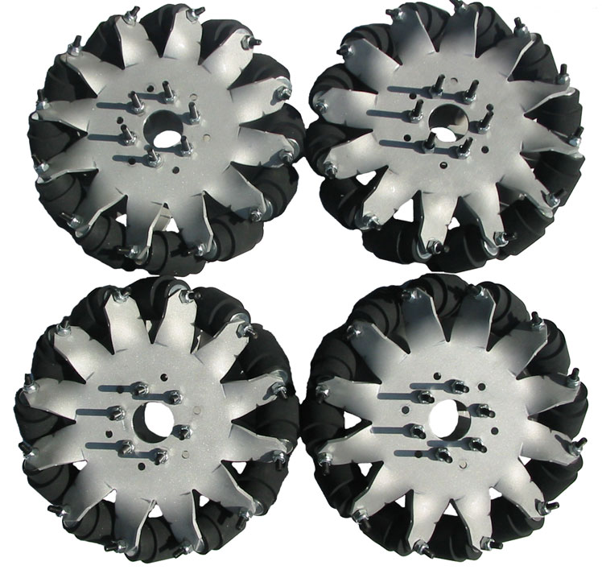
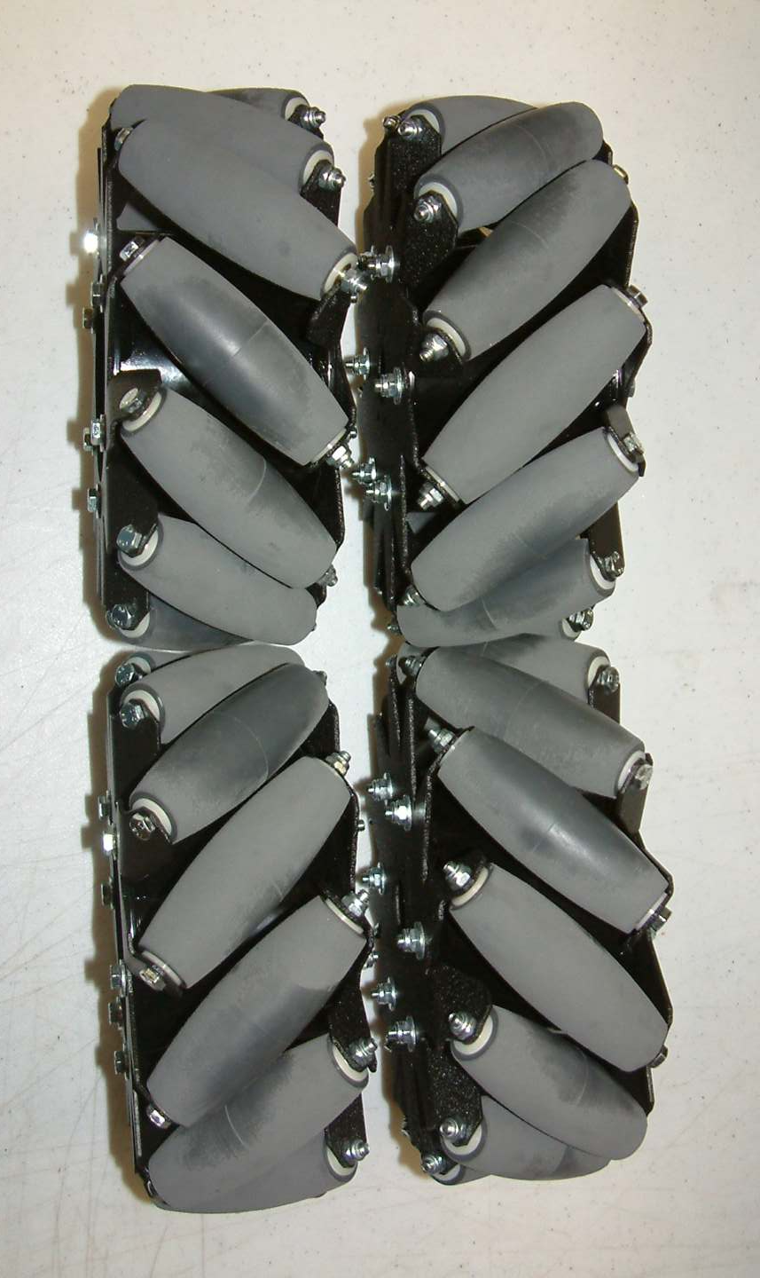
Omni: Mecanum Wheels
http://www.andymark.biz/mecanumwheels.html

Slide 24
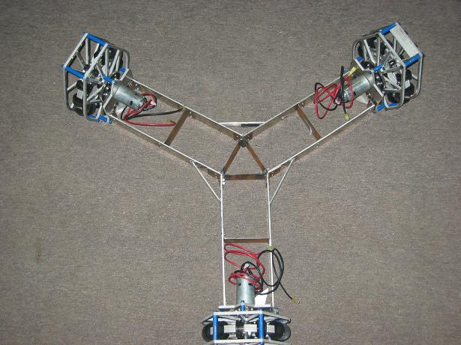
Omni: Holonomic / Killough
4-wheel drive needs square base for appropriate vector addition
Pros (+)
Turns around Center of robot
No complicated steering methods
Simultaneously used 2D motion and rotation
Maneuverability
Truly Any Direction of Motion
COTS parts
Cons (-)
Requires 3-4 independently powered motors
Weight
Cost
Programming Skill Necessary
NO Brake
Minimum Pushing Power
Climbing
Drifting (Weight Distribution)
3-wheel drive needs separated 120 degrees for appropriate vector addition

Slide 25
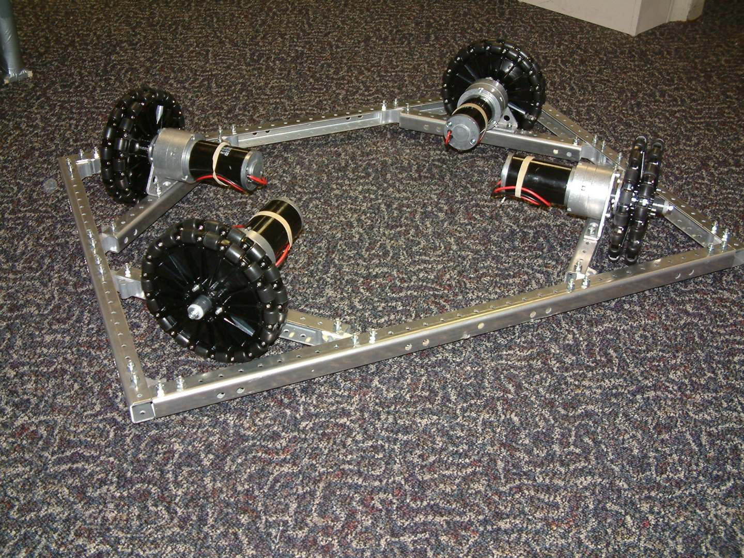
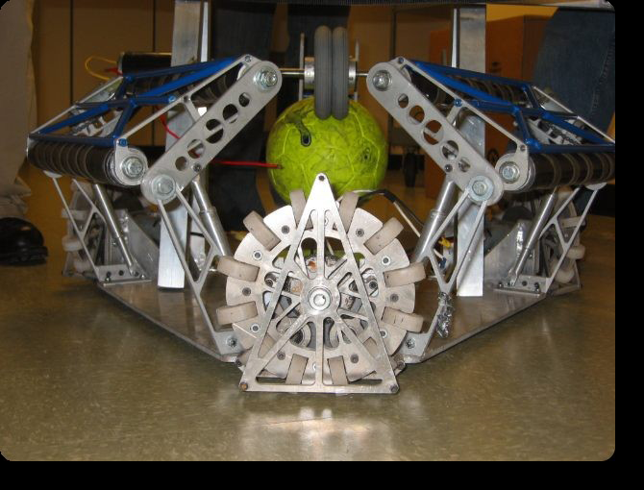
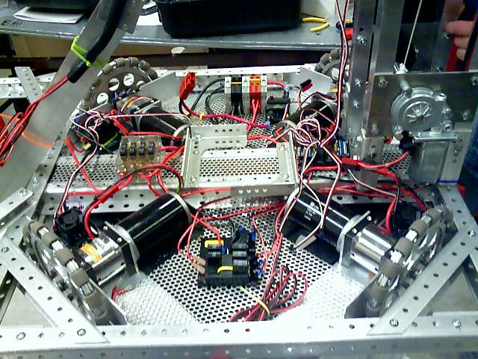
Omni: Holonomic Examples

Slide 26
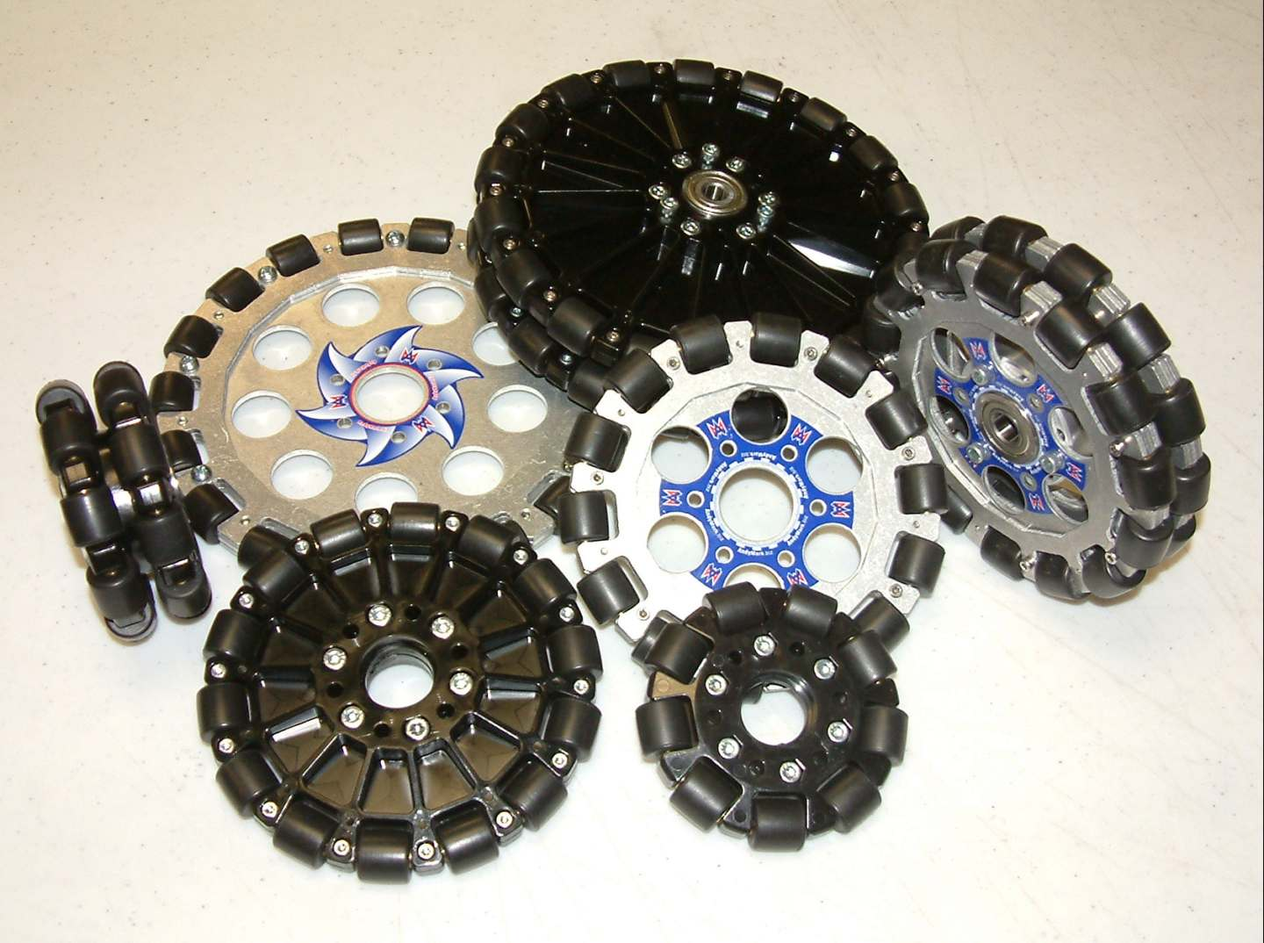
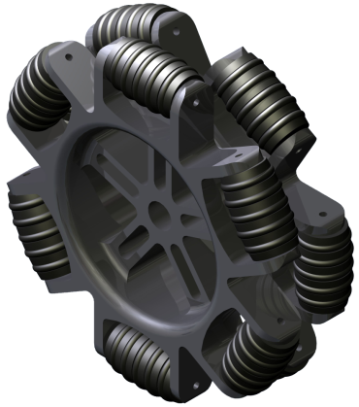
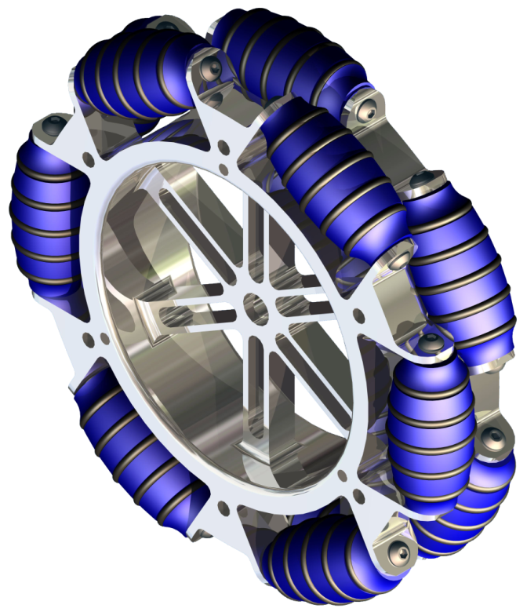
Omni: Holonomic/Omni Wheels
http://www.andymark.biz/omniwheels.html
Custom (1764)

Slide 27
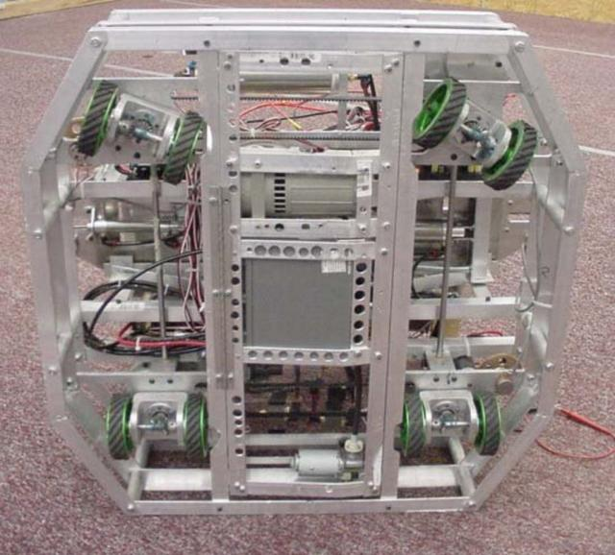
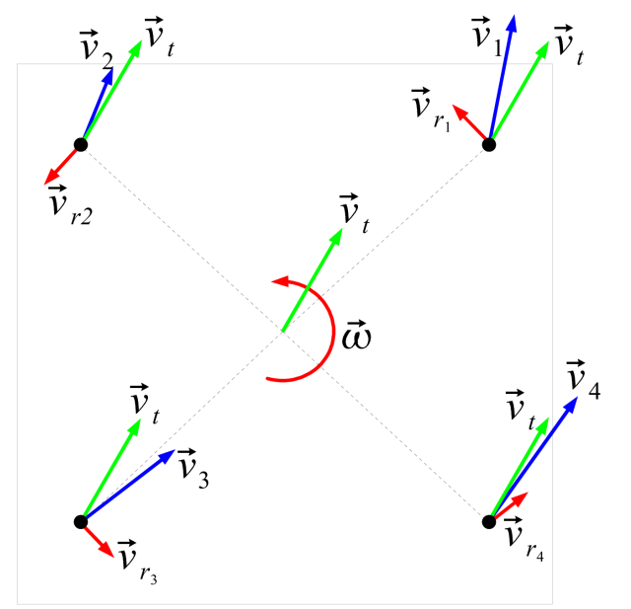
Omni: Sweve/Crab
All traction Wheels.
Each wheel rotates independently for steering
Pros (+)
Maneuverability
No Traction Loss
Simple wheels
Ability to hold/push
Cons (-)
Mechanically Complex
Weight
Programming
Control and Drivability
Wheel turning delay
Cost

Slide 28
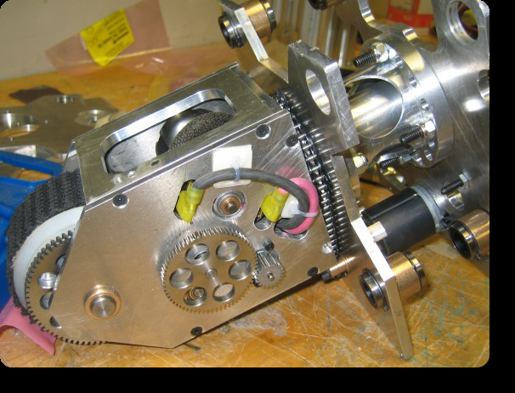
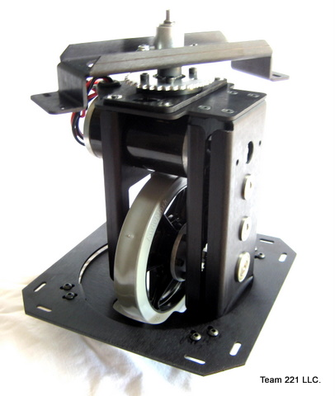
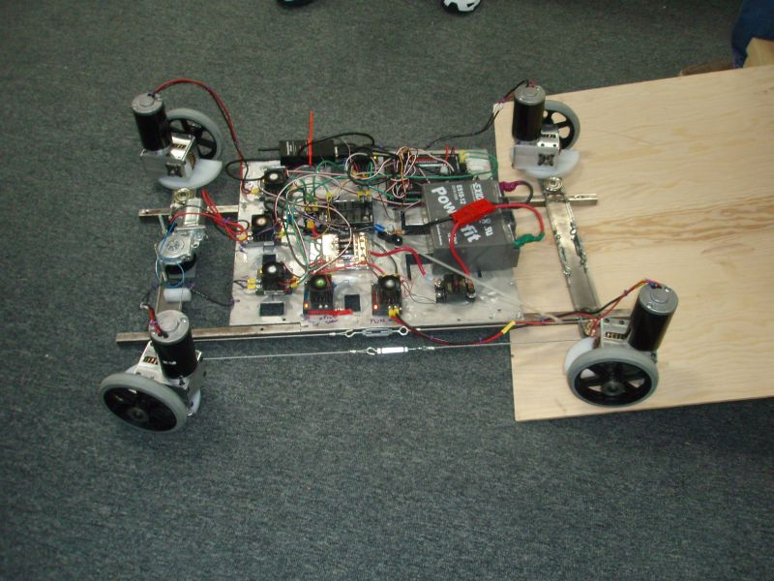
Omni: Swerve/Crab Exampe
Available at AndyMark.biz

Slide 29
Other Drive Systems
N Wheel Drive (More than 6)
Not much better driving than 6 wheel Drive
Improves climbing, but adds a lot of weight
3 Wheel Drive
Atypical – Therefore time intensive
Lighter than 4 wheel drive
Ball Drive
Rack and Pinion / Car Steering
Combination of any other drives

Slide 30
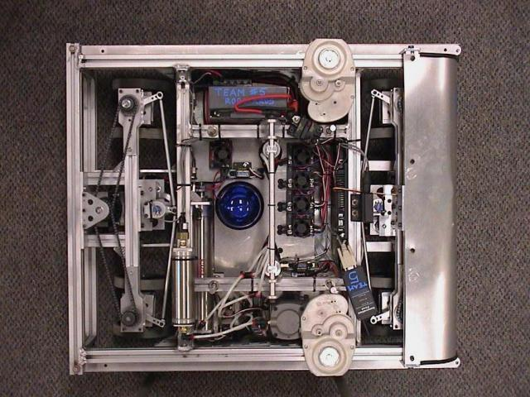
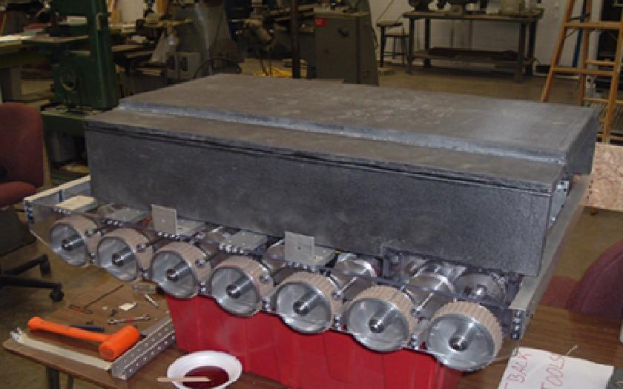
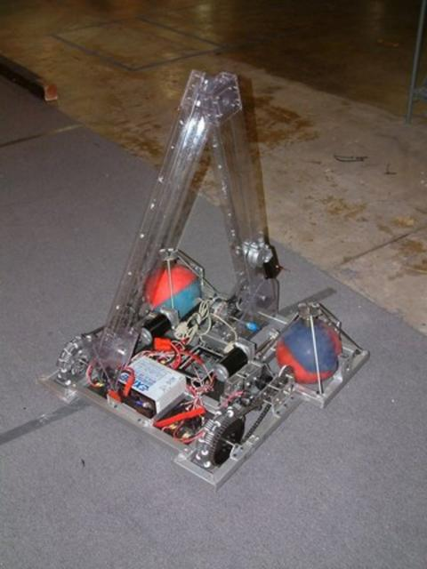
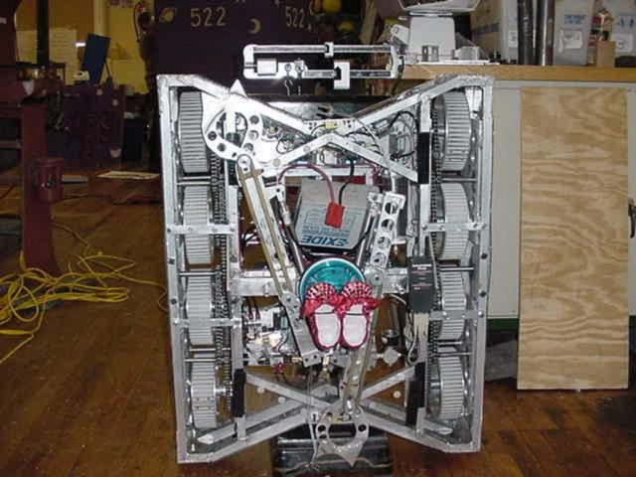
Other Drives: Examples

Slide 31
POWER and Power Transmission

Slide 32
How Fast?
Under 4 ft/s – Slow. Great pushing power if enough traction.
No need to go slower than the point that the wheels loose traction
5-7 ft/s – Medium speed and power. Typical of a single speed FRC robot
8-12 ft/s – Fast. Low pushing force
Over 13ft/sec – Crazy. Hard to control, blazingly fast, no pushing power.
Remember, many motors draw 60A+ at stall but our breakers trip at 40A!

Slide 33
Power
Motors give us the power we need to make things move.
Adding power to a drive train increases the rate at which we can move a given load or increases the load we can move at a given rate
Drive trains are typically not “power-limited”
Coefficient of friction limits maximum force of friction because of robot weight limit.
Shaving off .1 sec. on your ¼-mile time is meaningless on a 50 ft. field.

Slide 34
MORE Power
Practical Benefits of Additional Motors
Cooler motors
Decreased current draw; lower chance of tripping breakers
Redundancy
Lower center of gravity
Drawbacks
Heavier
Useful motors unavailable for other mechanisms

Slide 35
Power Transmission
Method by which power is turned into traction.
Most important consideration in drive design
Fortunately, there’s a lot of knowledge about what works well
Roller Chain and Sprockets
Timing Belt
Gearing
Spur
Worm
Friction Belt

Slide 36
Power Transmission: Chain
#25 (1/4”) and #35 (3/8”) most commonly used in FRC applications
#35 is more forgiving of misalignment; heavier
#25 can fail under shock loading, but rarely otherwise
95-98% efficient
Proper tension is a necessity
1:5 reduction is about the largest single-stage ratio you can expect

Slide 37
Power Transmission: Timing Belt
A variety of pitches available
About as efficient as chain
Frequently used simultaneously as a traction device
Treaded robots are susceptible to failure by side-loading while turning
Comparatively expensive
Sold in custom and stock length – breaks in the belt cannot usually be repaired

Slide 38
Power Transmission: Gearing
Gearing is used most frequently “high up” in the drive train
COTS gearboxes available widely and cheaply
Driving wheels directly with gearing probably requires machining resources
Spur Gears
Most common gearing we see in FRC; Toughboxes, NBD, Shifters, Planetary Gearsets
95-98% efficient PER STAGE
Again, expect useful single-stage reduction of about 1:5 or less

Slide 39
Power Transmission: Gearing
Worm Gears
Useful for very high, single-stage reductions (1:100)
Difficult to backdrive
Efficiency varies based upon design – anywhere from 40% to 80%
Design must compensate for high axial thrust loading

Slide 40
Power Transmission: Friction Belt
Great for low-friction applications or as a clutch
Apparently easier to work with, but requires high tension to operate properly
Usually not useful for drive train applications

Slide 41
TRANSMISSIONS

Slide 42
Transmissions / Gearbox
Transmission Goal:
Translate Motor Motion and Power into Robot Motivation
Motor:
Speed (RPMs)
Torque (ft-lbs or Nm)
Robot
Speed (feet per second [fps])
Weight

Slide 43
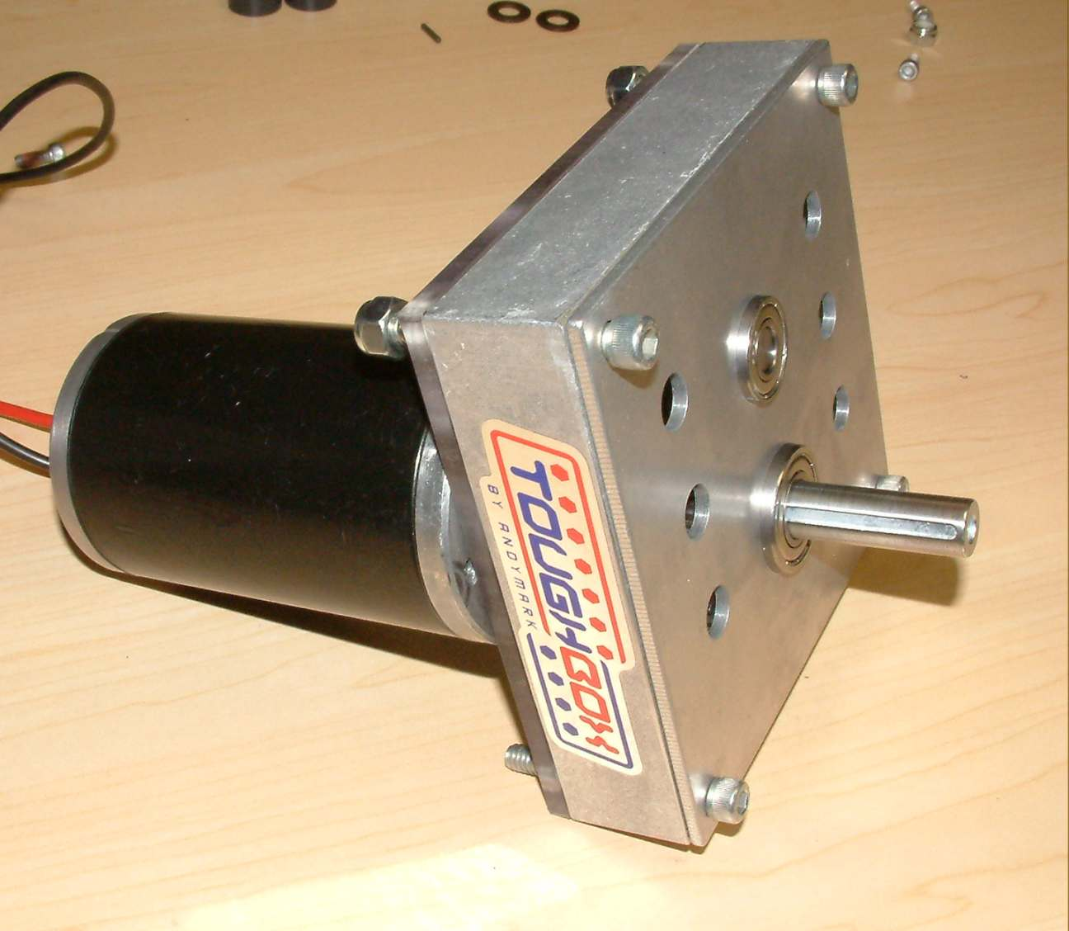
Transmissions – AM ToughBox
AndyMark ToughBox (AM-0145)
2 CIMs or 2 FP with AM Planetary GearBox
Overall Ratio: 12.75:1
Gear type: spur gears
Weight: 2.5 pounds
Options
Several Ratio options available (14.88:1 to 5.95:1)
Weight Reduction (Aluminum Gears)
$66.00
http://www.andymark.biz/am-0145.html

Slide 44
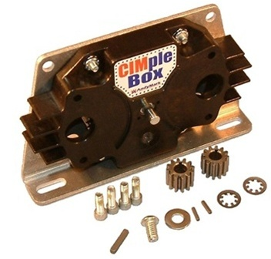
Transmissions – AM CIMple Box
AndyMark CIMple Box (AM-0734)
2 CIMs or 2 FP with AM GearBox
Overall Ratio: 4.67:1
Gear type: spur gears
Weight: 1.40 pounds
Options
Not many
Post for Optional Encoder
$50.00

Slide 45
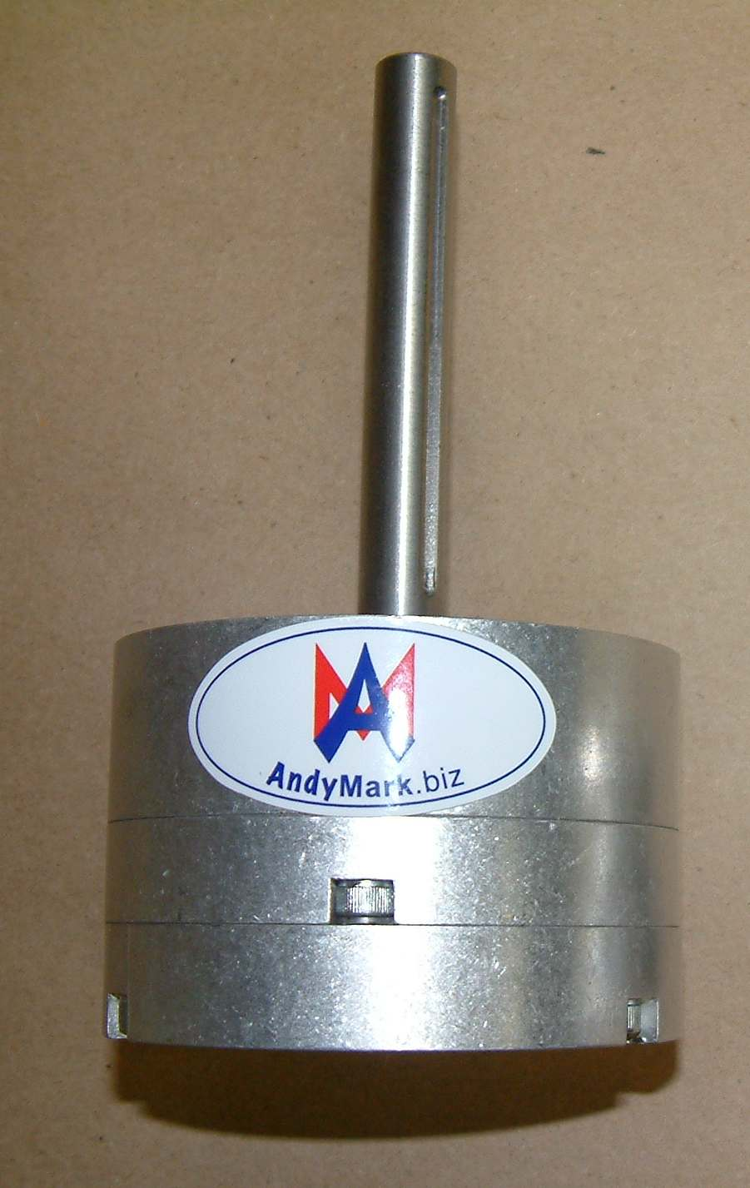
Tranmissions – AM GEM500
GEM500 Gearbox
Planetary Style
1 CIM or 1 FP with Planetary Gearbox
Weight: 2.4 pounds
Output Shaft: 0.50”
Gear Ratios
Each stage has a ratio of 3.67:1.
Base Stage: 3.67:1
Two Stages: 13.5:1
Three Stages: 45.4:1
Four Stages: 181.4:1
$120.00

Slide 46
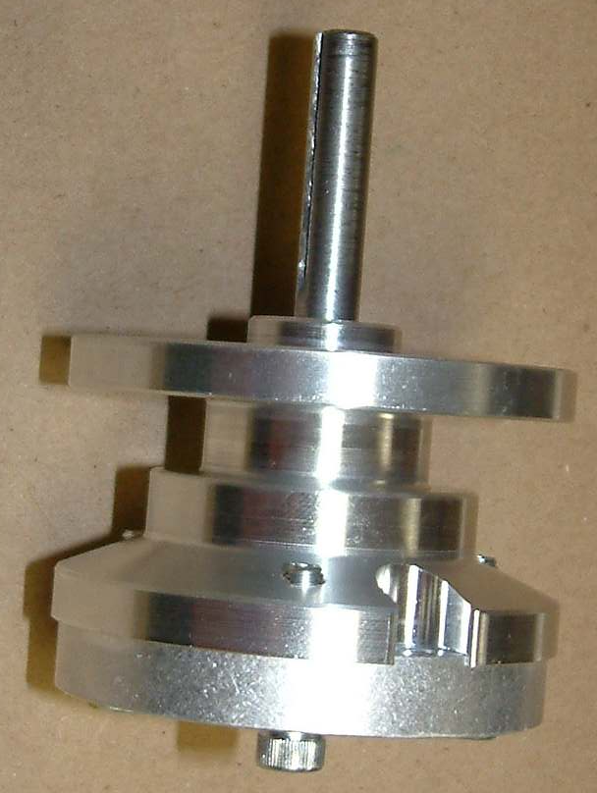
Transmissions – AM Planetary
AM Planetary Gearbox AM-0002
Same Mounting and Output as the CIM!
For Fischer Price Mabuchi Motor
Accepts Globe & CIM w/Alterations
Weight = 0.9 lbs
Gear Reduction
Single Stage: 3.67: 1
Matches CIM… sort of
$98.00
With motor Installed: $117.00

Slide 47
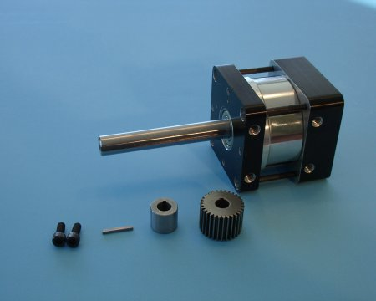
Transmissions – BB P80 Series
BaneBots Planetary GearBox
Max Torque: 85ft-lbs
Available with or without motor
Gear Ratios
3:1 4: 1 9:1
12:1 16:1 27.1
36:1 48:1 64:1
81:1 108:1 144:1
192:1 256:1
$79.50 - $157.25

Slide 48
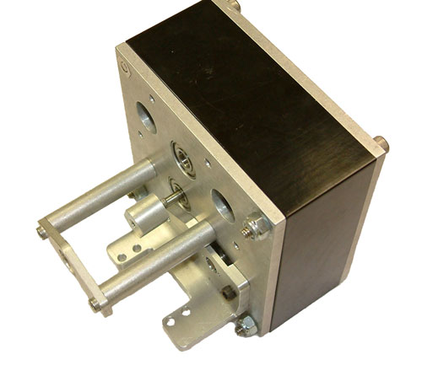
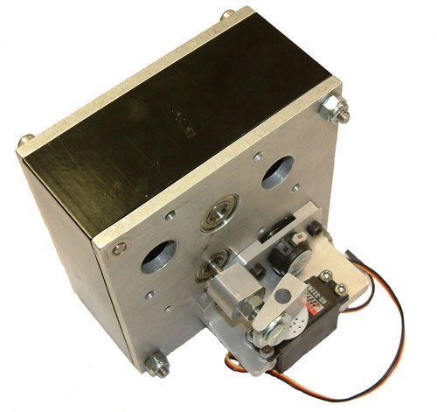
Shiftable Transmission: AndyMark (AM)
Super Shifter am-0114
Available from AndyMark
www.andymark.biz
Purchased as set
Cost with Shipping
$230.00 EACH

Slide 49
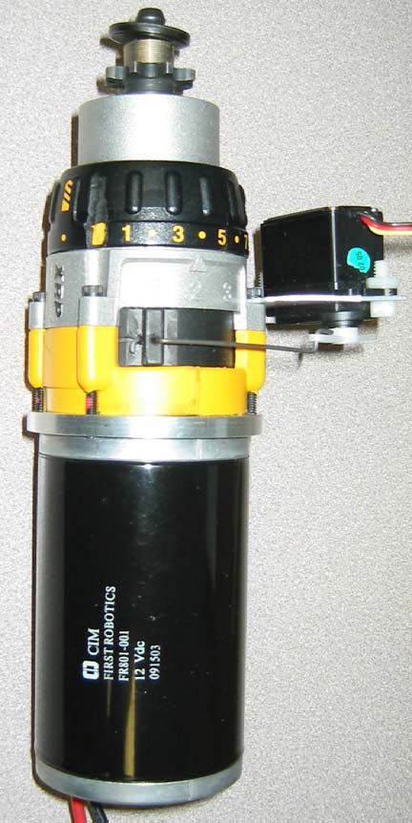
Shifting Transmissions: NDB
Nothing But DeWalts
Team Modifies DeWalt XRP Drill
Purchase Pieces and Assemble
Prices vary

Slide 50
Compare SS and NBD
Super Shifter AM
Nothing but dewalts
2 speed
Interface with
2 CIMs
2 AM Planetary Gearbox
Gear Reduction
67:1
17:1
Shifts on the fly
Servo
Pneumatic (Bimba series)
3 speed
Interface with 1:
Chiaphua (CIM)
Fischer Price
Globe Motor
Gear Reduction
47:1, 15:1, 12:1
Shifts on the fly
Servo only

Slide 51
Compare SS and NBD
Super Shifter AM
Nothing but dewalts
Weight: 3.6 lbs w/o motors
Size with:
CIM: 6” x 4.25” x 8.216
FP Mod: 6” x 4.25” x 10.344”
Comes with:
Optical Encoder
Servo Shifter
12 tooth #35 chain output sprockets per shaft
Optional to purchase
4:1 high/low ratio
Weight: < 2 lbs w/o motors
Size
CIM: 9.5” x 4” x 3”
Other: Varies on use
Does not come with
Servo
Servo Shifter
Encoder
Mounting plates

Slide 52
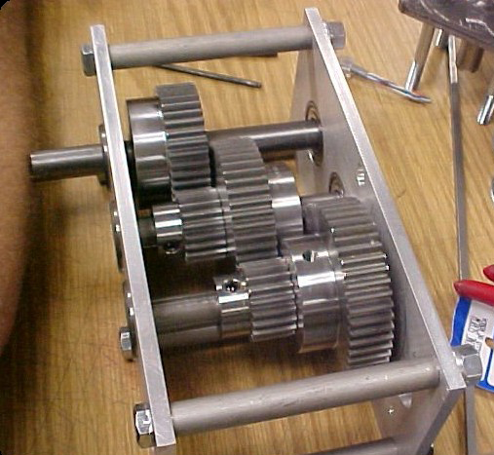
Custom Gearboxes
Many teams build their own gearboxes
Built to suit
Can be very rugged
Can include single or multiple motors
Easier to add custom and Advanced features
Shift, Encoders, Straffing, etc.

Slide 53
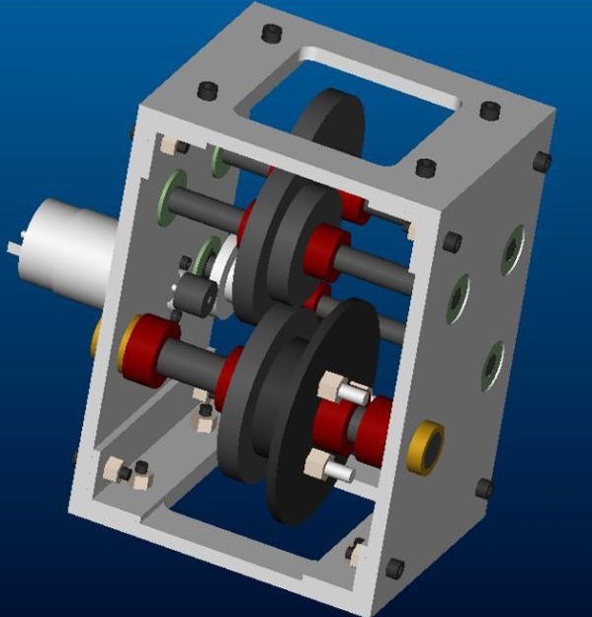
Basic Custom Gearbox
Two 1/4” aluminum plates to mount shafts, separated by either four posts or two more aluminum plates
Motor(s) bolted into back plate
Sprockets and chain to wheels

Slide 54
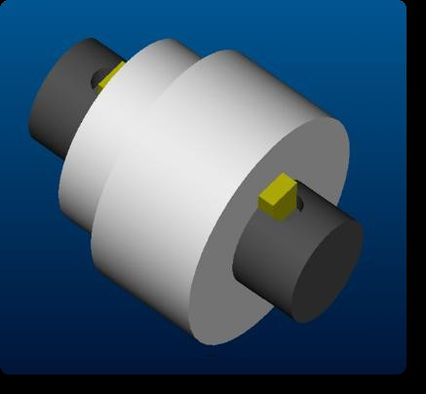
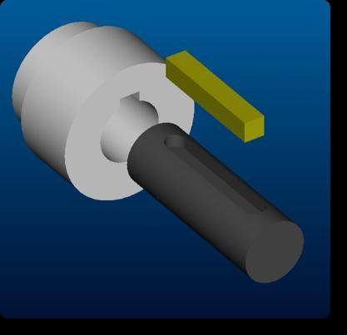
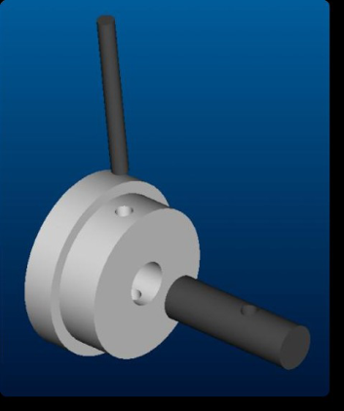
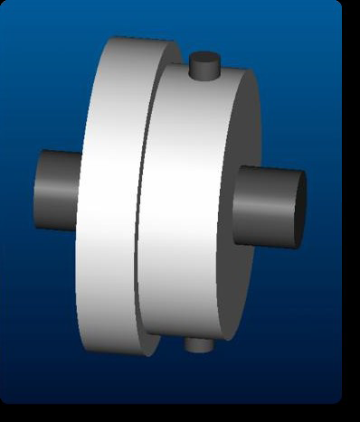
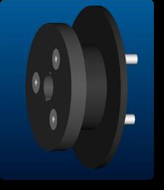

Basic Custom Gearbox: Power Transmisison
Keyways
Strong
Hard to machine Keyway
Pins
Easy to machine
Weaker
Set Screws
Avoid if possible
Loctite and Knurled if used
Bolts
Very effective for large gears/sprockets

Slide 55
TRACTION

Slide 56
Coefficient of Friction
Coefficient of Friction is Dependent on:
Materials of the robot wheels/belts
Shape of robot wheels/belts
Materials on the floor surface
Surface Conditions

Slide 57
Materials of the robot wheels/belts
High Friction Coefficient:
Soft Materials
“Spongy” Materials
“Sticky” Materials
Low Friction Coefficient:
Hard Materials
Smooth Materials
Shiny Materials
It is often the case that “good” materials wear out much faster than “bad” materials - don’t pick a material that is TOO good!

Slide 58



Shape of robot wheels/belts
Shape of wheel wants to “interlock” with the floor surface.

Slide 59

Materials on the floor surface
This is NOT up to you.
Know what surfaces you are running on:
Carpet,
“Regolith”
Aluminum Diamond Plate
Other
Follow rules about material contact
Too Much TRACTION for surface

Slide 60
Surface Conditions
Surface Conditions
In some cases this will be up to you
Good:
Clean Surfaces
“Tacky” Surfaces
Bad
Dirty Surfaces
Oily Surfaces
Don’t be too dependent on the surface condition since you can’t control it.
BUT… Don’t forget to clean your wheels

Slide 61
Traction Basics Terminology
maximum
tractive
force
Coefficient
of friction
x
Normal Force
(Weight)
torque
turning the
wheel
=
weight
tractive
force
normal
force
The coefficient of friction for any given contact with the floor, multiplied by the normal force, equals the maximum tractive force that can be applied at the contact area.
Source: Paul Copioli, Ford Motor Company, #217

Slide 62
Traction Fundamentals “Normal Force”
weight
front
normal
force
(rear)
normal
force
(front)
The normal force is the force that the wheels exert on the floor, and is equal and opposite to the force the floor exerts on the wheels. In the simplest case, this is dependent on the weight of the robot. The normal force is divided among the robot features in contact with the ground. Therefore: Adding more wheels DOES NOT add more traction -
Source: Paul Copioli, Ford Motor Company, #217

Slide 63
Traction Fundamentals “Weight Distribution”
more weight in back
due to battery and
motors
less weight in front
due to fewer parts
in this area
EXAMPLE
ONLY
front
Keep in mind weight distribution can change with moving parts
more
normal
force
less
normal
force
The weight of the robot is not equally distributed among all the contacts with the floor. Weight distribution is dependent on where the parts are in the robot. This affects the normal force at each wheel.
Source: Paul Copioli, Ford Motor Company, #217

Slide 64
PRACTICAL AND REALISTIC CONSIDERATIONS

Slide 65
Remember…
Most first teams overestimate their ability and underestimate reality.

Slide 66
Reality Check
Robot top speed will occur at approximately 80-85% of max speed.
Max speed CIM = 5600 rpms (NO LOAD)
Reality: 5600 x 0.85 = 4760 rpms
Friction is a two edged sword
Allows you to push/pull
Doesn’t allow you to turn
You CAN have too much of it!
Frequent for 4WD Systems

Slide 67
Tips and Good Practices
Most important consideration, bar none.
Three most important parts of a robot are, famously, “drive train, drive train and drive train.”
Good practices:
Support shafts in two places. No more, no less.
Reduces Friction
Can wear out faster and fail unexpectedly otherwise
Avoid long cantilevered loads
Avoid press fits and friction belting
Alignment, alignment, alignment!
Reduce or remove friction almost everywhere you can

Slide 68
Tips and Good Practices
You will probably fail at achieving 100% reliability
Good practices:
Design failure points into drive train and know where they are
Accessibility is paramount. You can’t fix what you can’t touch
Bring spare parts; especially for unique items such as gears, sprockets, transmissions, mounting hardware, etc.
Aim for maintenance and repair times of <4min.
TIMEOUTS!
Alignment, Alignment, Alignment….Alignment
Use lock washers, Nylock nuts or Loctite EVERYWHERE

Slide 69
Tips and Good Practices
Only at this stage should you consider advanced thingamajigs and dowhatsits that are tailored to the challenge at hand
Stairs, ramps, slippery surfaces, tugs-of-war
“Now that you’ve devised a fantastic system of linkages and cams to climb over that wall on the field, consider if it’d just be easier, cheaper, faster and lighter to drive around it.”

Slide 70
Credits
AndyMark, Inc.
BaneBots.com
FIRST Robotics Drive Systems; Andy Baker, President: AndyMark, Inc.
FIRST Robotics Drive Trains; Dale Yocum
FRC Drive Train Design and Implementation; Madison Krass and Fred Sayre, Team 448
Mobility: Waterloo Regional; Ian Makenzie
Robot Drive System Fundamentals – FRC Conference: Atlanta, GA 2007
Ken Patton (Team 65), Paul Copioli (Team 217)
www.chiefdelphi.com
www.chiefdelphi.com/forums/papers.php
http://www.firstroboticscanada.org/site/node/71

